Slide 1
KNOW YOUR TISSUES!

Slide 2
SIMPLE SQUAMOUS EPITHELIUM

Slide 3
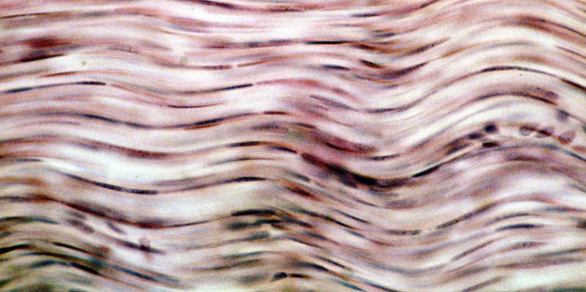
DENSE CONNECTIVE TISSUE

Slide 4
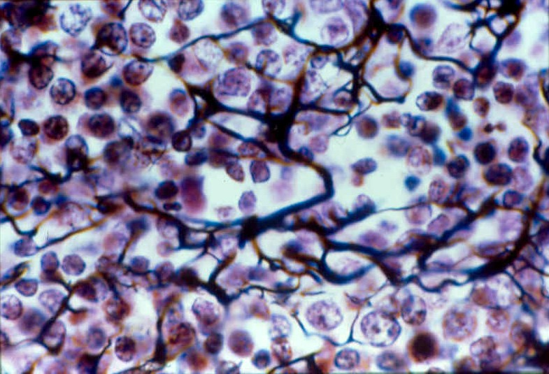
RETICULAR (CONNECTIVE TISSUE)

Slide 5
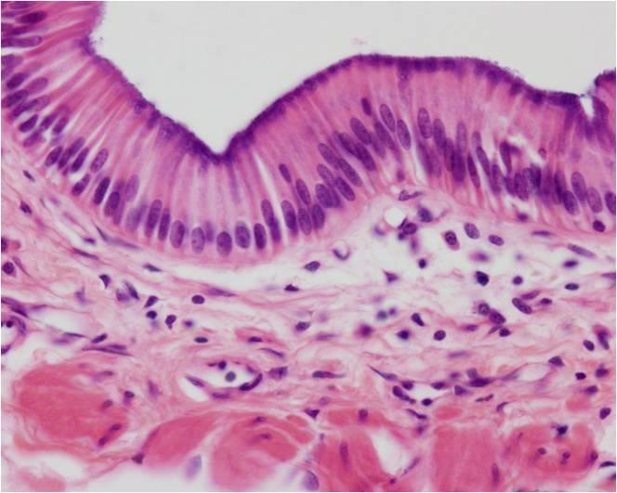
SIMPLE COLUMNAR EPITHELIUM

Slide 6
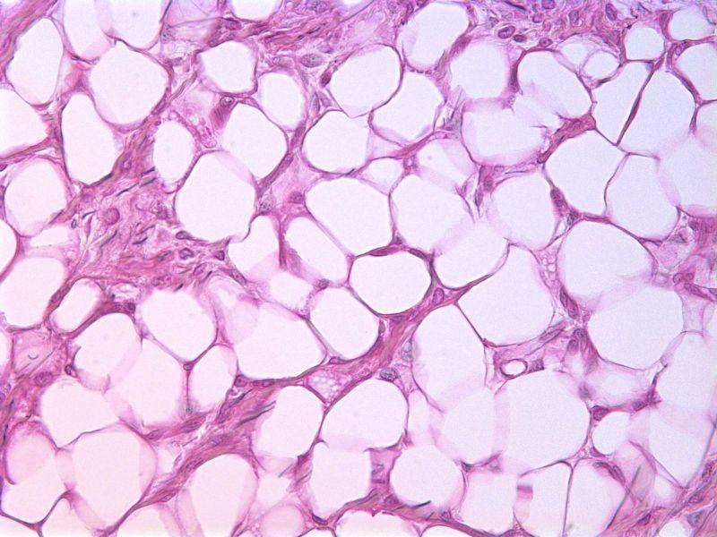
ADIPOSE CONNECTIVE TISSUE

Slide 7
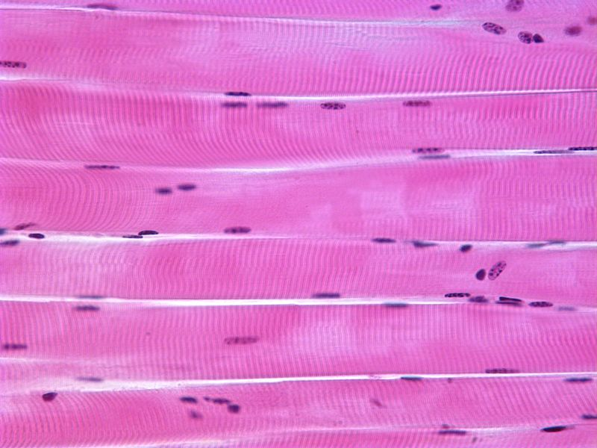
SKELETAL MUSCLE

Slide 8
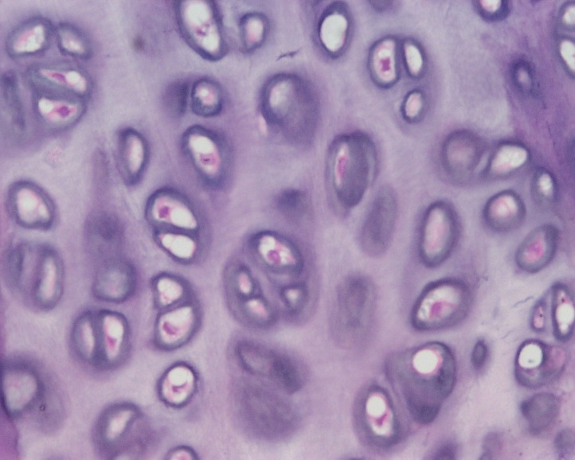
HYALINE CARTILAGE (CONNECTIVE TISSUE)

Slide 9
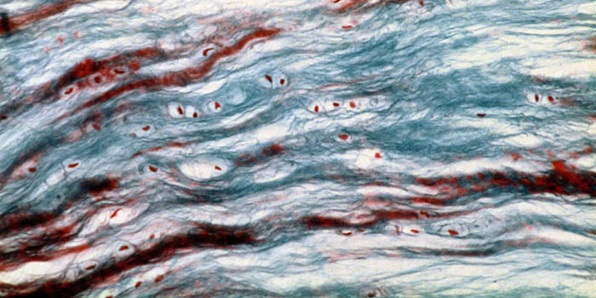
FIBROCARTILAGE (CONNECTIVE TISSUE)

Slide 10
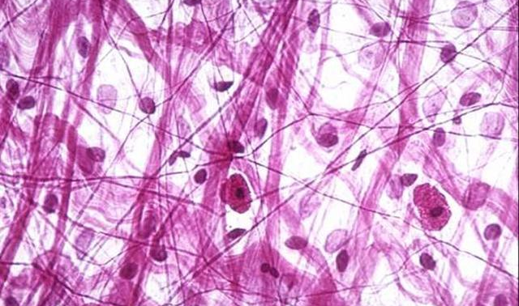
AREOLAR CONNECTIVE TISSUE

Slide 11
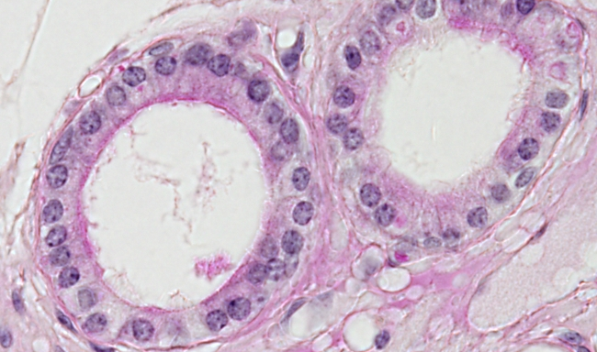
SIMPLE CUBOIDAL EPITHELIUM

Slide 12
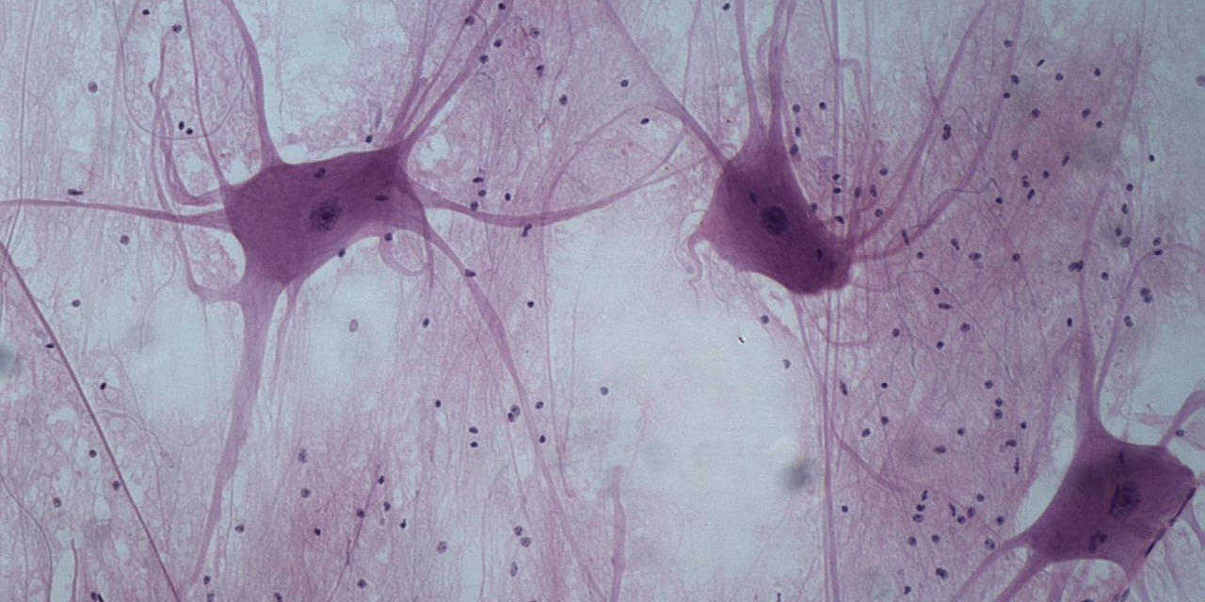
NERVOUS TISSUE

Slide 13
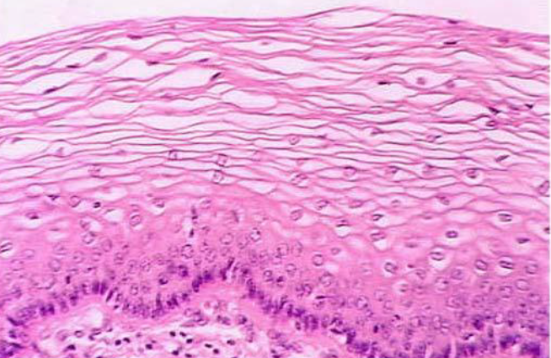
STRATIFIED SQUAMOUS EPITHELIUM

Slide 14
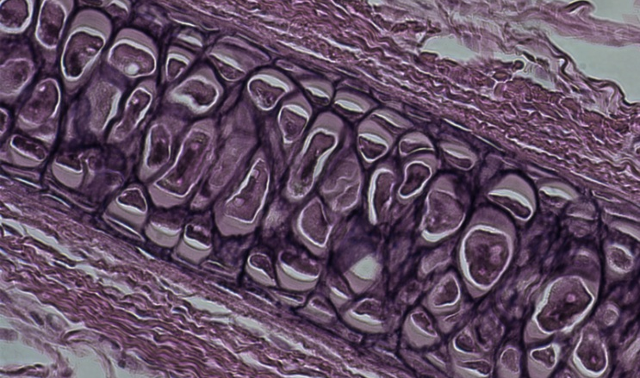
ELASTIC CARTILAGE (CONNECTIVE TISSUE)

Slide 15
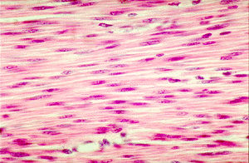
SMOOTH MUSCLE

Slide 16
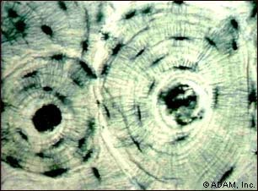
BONE

Slide 17
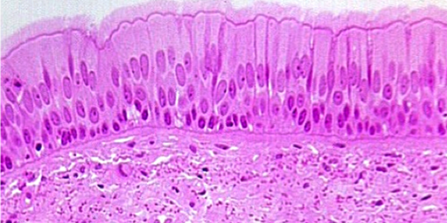
PSEUDOSTRATIFIED EIPITHELIUM

Slide 18
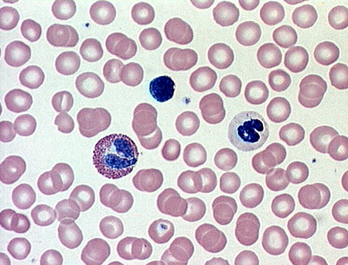
BLOOD

Slide 19
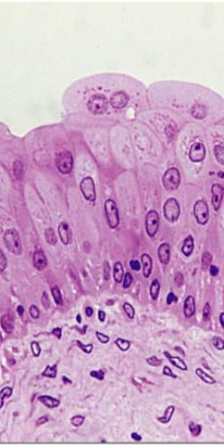
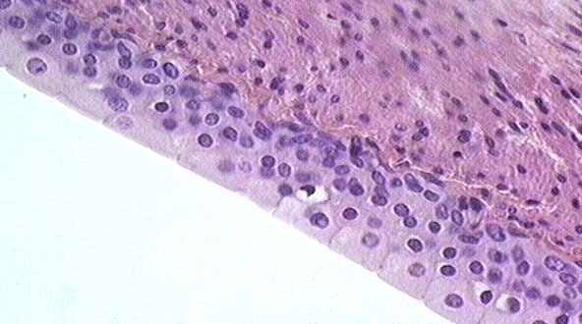
TRANSITIONAL EPITHELIUM

Slide 20
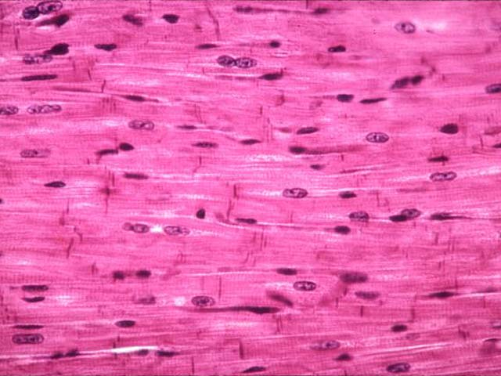
CARDIAC MUSCLE

Slide 21
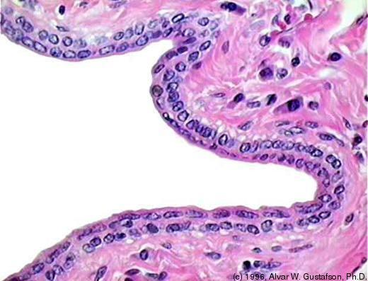
STRATIFIED CUBOIDAL EPITHELIUM

